Slide 1
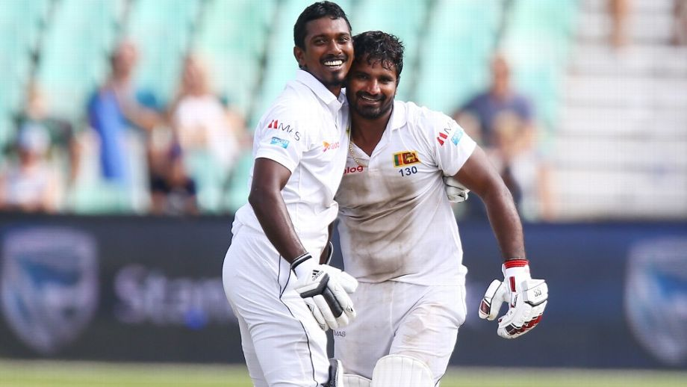

Slide 2

When Kusal Perera defied logic - Cricbuzz
Kusal Perera bats with body, heart and soul in innings of a lifetime – ESPNCricInfo
A stunning one wicket win over South Africa - BBC Sports
One of the greatest Test innings of all time – NDTV Sports

Slide 3
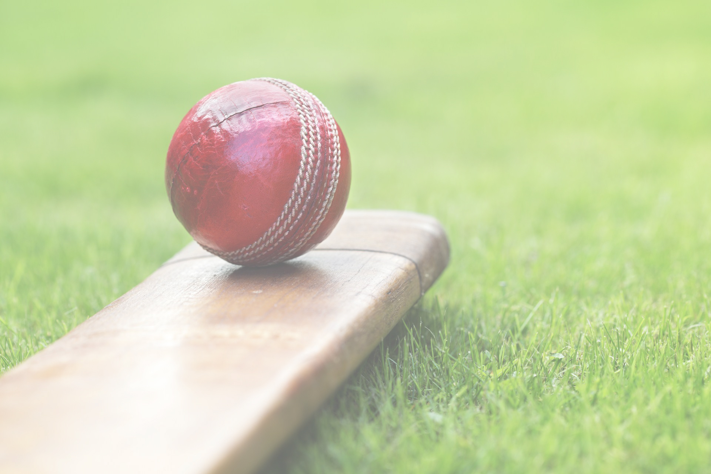
CRICKET SABERMETRICS
GROUP 20
S. NILUCSHAN (E/13/239)
U. I. PERERA (E/13/258)
G. G. S. THEJAWANSA (E/13/366)
Performance analysis of a selected Cricket team using Data Mining and Machine Learning

Slide 4
What is Sabermetrics?
Derived from the acronym SABR which stands for Society of American Baseball Research.
Study of the game of baseball through observations and experiments.
Simplified version – Scientific and objective analysis of baseball.

Slide 5
Cricket Sabermetrics
If the use of Sabermetrics has transformed a statistics-heavy sport like baseball, could it possibly do the same for cricket?
A system to identify hidden patterns and predict possible outcomes of a cricket match.

Slide 6


Data
Performance Analysis Criteria
Machine Learning
Findings & Results

Slide 7
Similar Works
Works done by E11 batch students,
Identifying the attributes effect the outcome of a match.
14 attributes were identified.
Innings was divided into three segments and attributes were analyzed.
FINAL RESULT : Impact on selected attributes towards the final outcome of the match was analyzed.

Slide 8
Similar Works ctd..
Works done by E12 batch students,
Identifying the optimal set of attributes effect the outcome of a match.
23 attributes were selected.
Different combination of these attributes were analyzed.
FINAL RESULT : 9 attributes were resulted as the optimal set of attributes having high impact on end results of a match.

Slide 9

Problems in majority of works
How to prove our predictions are better than others?
How to prove our metrics are better than others?
How to validate our predictions in a real match?
Application of intuitive or domain based knowledge !!!

Slide 10

Data mining without applying domain knowledge
USEFUL
information
NOT USEFUL
information

Slide 11
Project
Domain knowledge based analysis
Random analysis
Machine Learning Algorithms
Classifiers

Slide 12
Methodology
Performance Evaluation
Team wise Evaluation
Player wise Evaluation
Prediction of batting and bowling position
Performance metrics evaluation and ranking

Slide 13
1. Team wise evaluation
556 matches played by Sri Lankan cricket team from 2006 to 2017.
Modelled as a supervised learning problem.
10 attributes were extracted from the data set.
Finding association rules. (Relationship within attributes)
Attribute set was labelled with WIN, LOSE and DRAW.
Modelled as a classification problem.

Slide 14
1. Team wise evaluation ctd..
Selected attributes
City | Toss winner
Venue | Toss decision
Match Type | Winner
Number of Overs | Player of the match
Opposition | Others

Slide 15
1. Team wise evaluation ctd..
Accuracy comparison of algorithms
Algorithm | Accuracy
Logistic Regression (Binomial) | 0.4536
Logistic Regression (Multinomial) | 0.4218
Decision Tree | 0.4602
Naïve Bayes | 0.6209
K-Nearest Neighbors | 0.5324
Random Forest | 0.6103
SVM (Radial Kernel) | 0.7021
2
3
1

Slide 16
2.1. Prediction of batting & bowling positions
Used to predict optimal batting and bowling positions for a given player.
Batting position - Model consisted of three predictor variables and one response (label) variable. Innings of a batsman was divided into three segments power play (first 6 overs), middle overs (next 10 overs) and death overs (last 4 overs) and runs scored in these segments were used as the three predictor variables. Batting position was considered as the response variable.
Bowling position - Model consisted of three predictor variable and four response variables. Innings of a bowler was divided into three segments power play, middle overs and death overs and runs given in these segments were used as the three predictor variables. Maximum possible four bowling positions were the response variable.

Slide 17
2.1. Prediction of batting & bowling positions ctd..
Batting prediction model (IPL match data)
Algorithm | Correct predictions | Correct prediction ± 1
Decision tree | 0.32 | 0.78
Random forest | 0.31 | 0.74
K-Nearest Neighbors | 0.28 | 0.69
SVM | 0.27 | 0.74
Gaussian Naïve Bayes | 0.19 | 0.48
Multinomial Naïve Bayes | 0.29 | 0.64
Bernoulli Naïve Bayes | 0.28 | 0.72
1
2
3

Slide 18
2.1. Prediction of batting & bowling positions ctd..
Batting prediction model (Int. T20 match data)
Algorithm | Correct predictions | Correct prediction ± 1
Decision tree | 0.37 | 0.85
Random forest | 0.37 | 0.81
K-Nearest Neighbors | 0.35 | 0.82
SVM | 0.25 | 0.74
Gaussian Naïve Bayes | 0.30 | 0.77
Multinomial Naïve Bayes | 0.29 | 0.79
Bernoulli Naïve Bayes | 0.21 | 0.70
1
3
2

Slide 19
2.1. Prediction of batting & bowling positions ctd..
Bowling prediction model (IPL match data)
Algorithm | Correct predictions | Correct prediction ± 1
Decision tree | 0.29 | 0.54
Random forest | 0.28 | 0.53
K-Nearest Neighbor | 0.27 | 0.49
1
2
3

Slide 20
2.1. Prediction of batting & bowling positions ctd..
Bowling prediction model (Int. T20 match data)
Algorithm | Correct predictions | Correct prediction ± 1
Decision tree | 0.29 | 0.54
Random forest | 0.28 | 0.53
K-Nearest Neighbor | 0.27 | 0.49
1
2
3

Slide 21
2.2. Performance metrics evaluation and ranking
Player was evaluated based on performance evaluation metrics.
This phase contains only evaluation of batsmen.
Batsman evaluation done on three key metrics,
Average
Strike Rate
Evaluation Score – Probability of a player to achieve average performance where it is given that other players have achieved their average performance.

Slide 22
2.2. Performance metrics evaluation and ranking ctd..
Player was given a score.
Players were ranked based on their score.
Players’ collective score was used to give a score for the team.
Higher score indicates high performance team.

Slide 23
2.2. Performance metrics evaluation and ranking ctd..
Attribute weights of player evaluation model
Attribute | Weight | Standard Error
Batting Average | 0.01442286 | 0.01394049
Strike Rate | 1.23438038 | 0.08286316
ROC | 1.78483827 | 0.56422746
Run Produced | 1.78771888 | 0.56430196
fours | 0.59532027 | 0.42977277
sixes | 2.217309715 | 0.94357401
innings | 1.342090863 | 1.20595439
No, Dismissal | -1.165790524 | 1.45965066
balls Faced | -0.06505113 | 0.06016719
dots | -0.099502378 | 0.18600119
byes | 0.987682686 | 0.17422221

Slide 24
2.2. Performance metrics evaluation and ranking ctd..
Performance scores of IPL teams
Team | Team score | Actual rank
Mumbai Indians | 36.3050 | 1
Rising Pune Supergiant | 18.9457 | 2
Sunrisers Hyderbad | 18.9409 | 3
Kolkata Knight Riders | 16.2032 | 4
Royal Challengers Bangalore | 15.2791 | 8
Delhi Daredevils | 14.4269 | 6
Kings 11 Punjab | 9.6930 | 5
Gujarat Lions | 6.4708 | 7

Slide 25
Conclusion
Given a team, we can predict outcome of a match.
Given a team, we can propose optimal batting and bowling positions for its players.
Given a team, we can measure it strength based on our evaluation score.

Slide 26
Future Works
Including bowling, fielding performance metric evaluation in the second model.
Developing a user friendly application by combining proposes three models.

Slide 27




Technologies used
R - Analysis
Python - Analysis
SQL (Microsoft SQL Server) - Application
Java - Data extraction

Slide 28


Additional Works
Hosted Source code for collaborative development in GitHub, Kaggle profiles

Slide 29
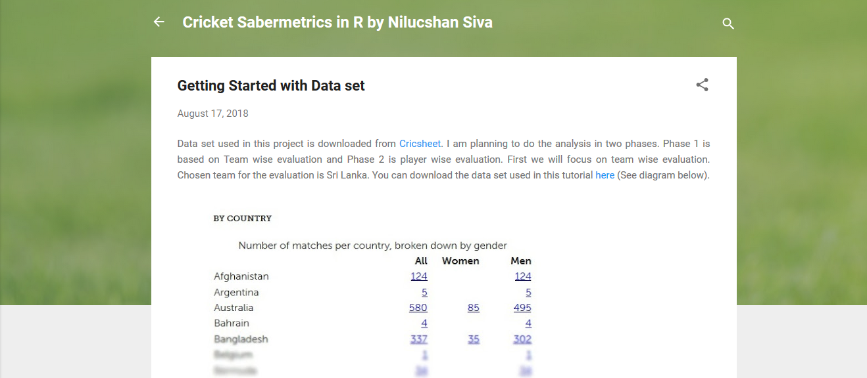
Additional Works Ctd.
Writing a blog on our approach towards analyzing cricket data

Slide 30
THANK YOU

Slide 31
Q & A

